Slide 1

Mood Tasker – A Mood-Based Productivity Web App
👩‍💻 Name: Krisha Keraliya
🎓 Semester: B.Tech IT – 5th Sem
🏫 College: [Your College Name]
📅 Academic Year: 2024–25
kk
by krisha keraliya

Slide 2

Introduction to Mood Tasker
Mood Tasker is a web-based productivity app designed to help users organize tasks based on their current emotional state. It encourages personalized focus, structured planning, and mindful breaks — all aligned with how the user feels. We believe productivity should adapt to you, not the other way around.

Slide 3

Addressing the Productivity Paradox
🔸 Most productivity tools ignore a user’s mental state.
🔸 Stress, burnout, or demotivation affects task execution.
🔸 There's a lack of tools that adapt to mood-driven productivity.
👉 A more human-centered, adaptive task manager is needed.

Slide 4





Mood Tasker: The Adaptive Solution
Mood Tasker adapts to how you feel, ensuring your tasks align with your emotional state for optimal performance and well-being. This personalized approach fosters sustainable productivity.
Mood Selection
Choose from states like Relaxed, Stressed, Happy, or Okay.
Tailored Tasks
The app suggests tasks and adjusts settings accordingly.
Personalized Breaks
Offers mood-appropriate break routines and timers.
Progress Tracking
Monitors your productivity and provides revision reminders.

Slide 5
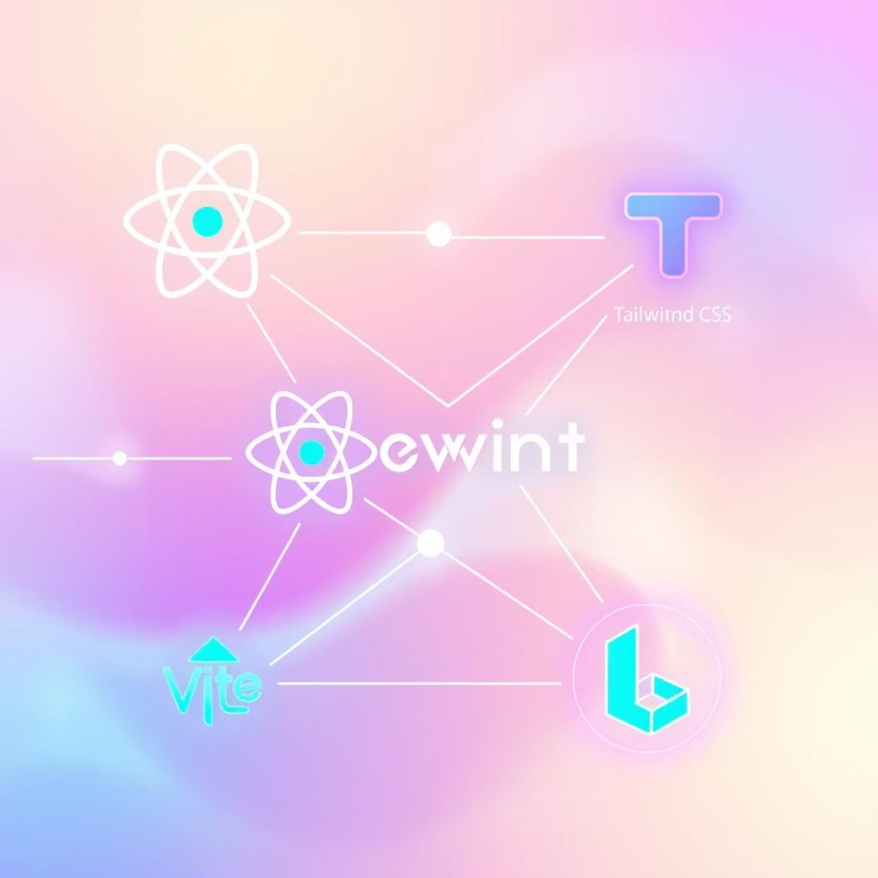
Robust Tech Stack
Our foundation is built on modern and efficient technologies, ensuring a fast, responsive, and scalable application:
ReactJS
Component-based frontend for dynamic UIs.
Tailwind CSS
Utility-first styling for a beautiful, responsive design.
Vite
A fast development environment for rapid iteration.
LocalStorage
Ensures task persistence without a dedicated backend.

Slide 6












Intuitive System Flow
Mood Tasker guides users through a seamless workflow, from mood selection to task completion and long-term planning.
1. Select Mood
2. Enter Main Task
User chooses their current emotional state.
Define the primary task for the session.
6. Summary & Revision
3. Take Breaks
Review progress and get spaced repetition reminders.
Optional mood-based breaks with timers.
5. Weekly Planner
4. Save Status
Organize tasks for the entire week.
Task completion status is recorded.

Slide 7
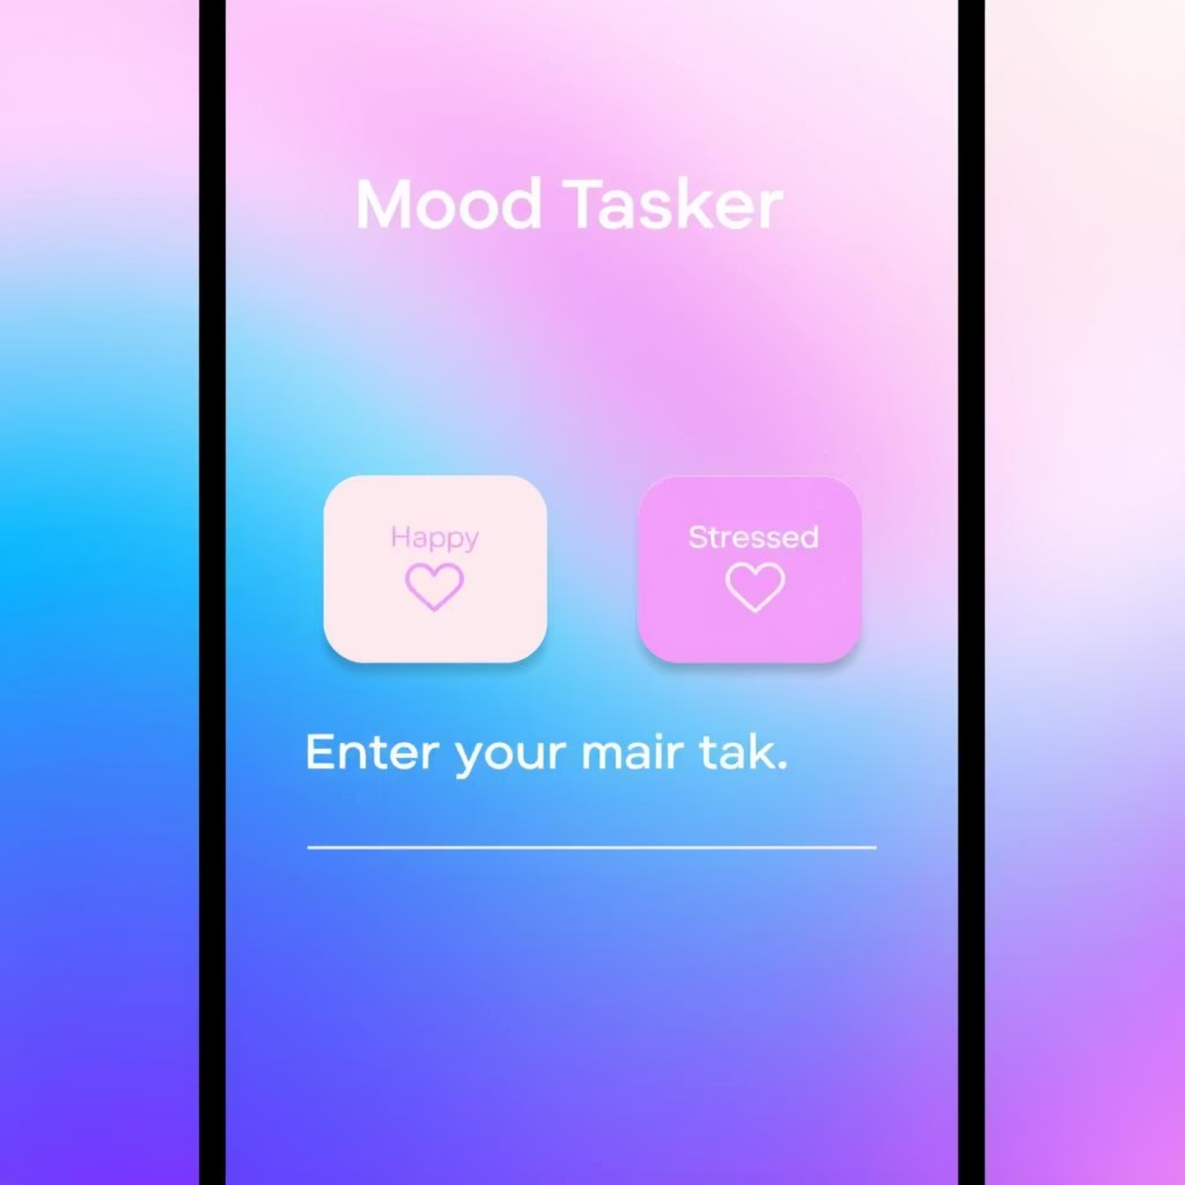
Feature Highlight: Mood Selection + Task Input
🧠 Based on selected mood:
The user enters their main task
Mood is saved with the task
Colors, layout, and reminders adjust accordingly
This adaptive interface ensures that the app always aligns with your mental state, optimizing your focus.

Slide 8
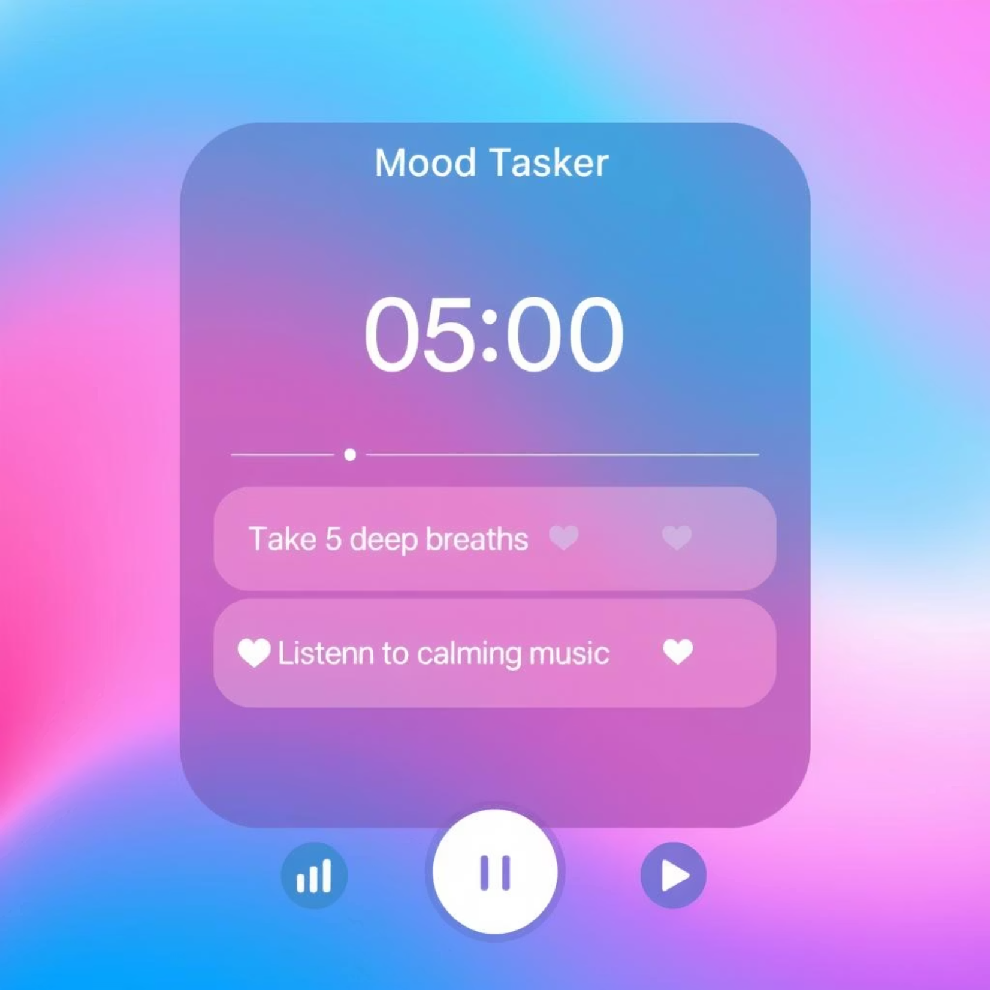
Feature Highlight: Break Page with Timer
🌿 Take mood-based breaks to refresh your mind:
Suggestions like breathing exercises, listening to music, or light stretching.
Integrated 5 or 10-minute timers for structured breaks.
Auto-redirect back to the task page after the break, maintaining flow.
These mindful pauses enhance mental well-being and sustained productivity.

